Slide 1

Agile Approach
Joey Haynes
CS-250 7-1 Final Project

Slide 2
Introduction
This presentation will give an overview of:
The Scrum-Agile approach,
Important facts
Explain the differences in processes between waterfall and agile development approaches

Slide 3
Scrum-Agile Team Roles
Product Owner
Maximizes the value of the product and the work of the Development team
Responsible for managing the Product Backlog
Represents the business sponsor
Provides direction to the team and prioritizes the work to be completed
Scrum Master
Makes sure Scrum is understood and enacted
Ensures that the Scrum team follows Scrum Theory, rules and practices
Promotes an effective Product Backlog management
Helps the development team create high-value products
Removes any obstacles that may hinder progress
Holds Scrum events

Slide 4
Scrum-Agile Team Roles cont.
Tester
Defines acceptance criteria and acceptance tests
Clarifies any problems found in the code and user stories
Executes tests and analyzes results
Collaborate with the team to fix any issues
Developer
Develops code according to solid software engineering practices
Involved in peer reviews
Collaborate with the team to create enough design so there’s time to iterate

Slide 5
Phases of SDLC in Agile
SDLC Phases:
Planning
Requirements
Design
Development
Deployment
Maintenance
Testing
Scrum-Agile Methodology
Adaptable and continuous improvement method that has focus on short iterations
Empirical process with frequent adaptations and inspections
Trial and Error approach
Information is acquired by means of experimentation and observation
The phases of the SLDC are cyclical rather than a straight, sequential process

Slide 6
Phases of SDLC in Agile cont.
Requirements:
Defined as project progress
Product Backlog:
Prioritized list of work to be done
In the form of user stories
Constantly being updated and managed by the Product Owner
Planning
Sprint Planning:
Meeting that takes place prior to the beginning of every sprint
Product Owner and team discuss what user stories will be used in the sprint
Team defies the tasks that will be needed to implement the user stories
Tasks will be separated among team memebers

Slide 7
Phases of SDLC in Agile cont.
Design, Development, Testing and Deployment:
These stages are done simultaneously within each sprint
Sprints typically last 1-4 weeks ending with a Sprint Review
Daily Scrums help monitor progress and identify any obstacles that may be slowing the progress
The team presents finished work at the end of each sprint during the Sprint Review
The team discuss what is working well, what is not, and identifies areas of improving that will take place in the next sprint

Slide 8
Phases of SDLC in Agile cont.
Final Development and Maintenance
Final Sprint Review will be held every day
This helps the team gain velocity and provide a better product for the customers
Once the product is released and end users can use it, the product is considered deployed and maintenance mode starts
During the maintenance mode, the product will be updated for the customer as issues are brought to light and additional improvements are requested

Slide 9
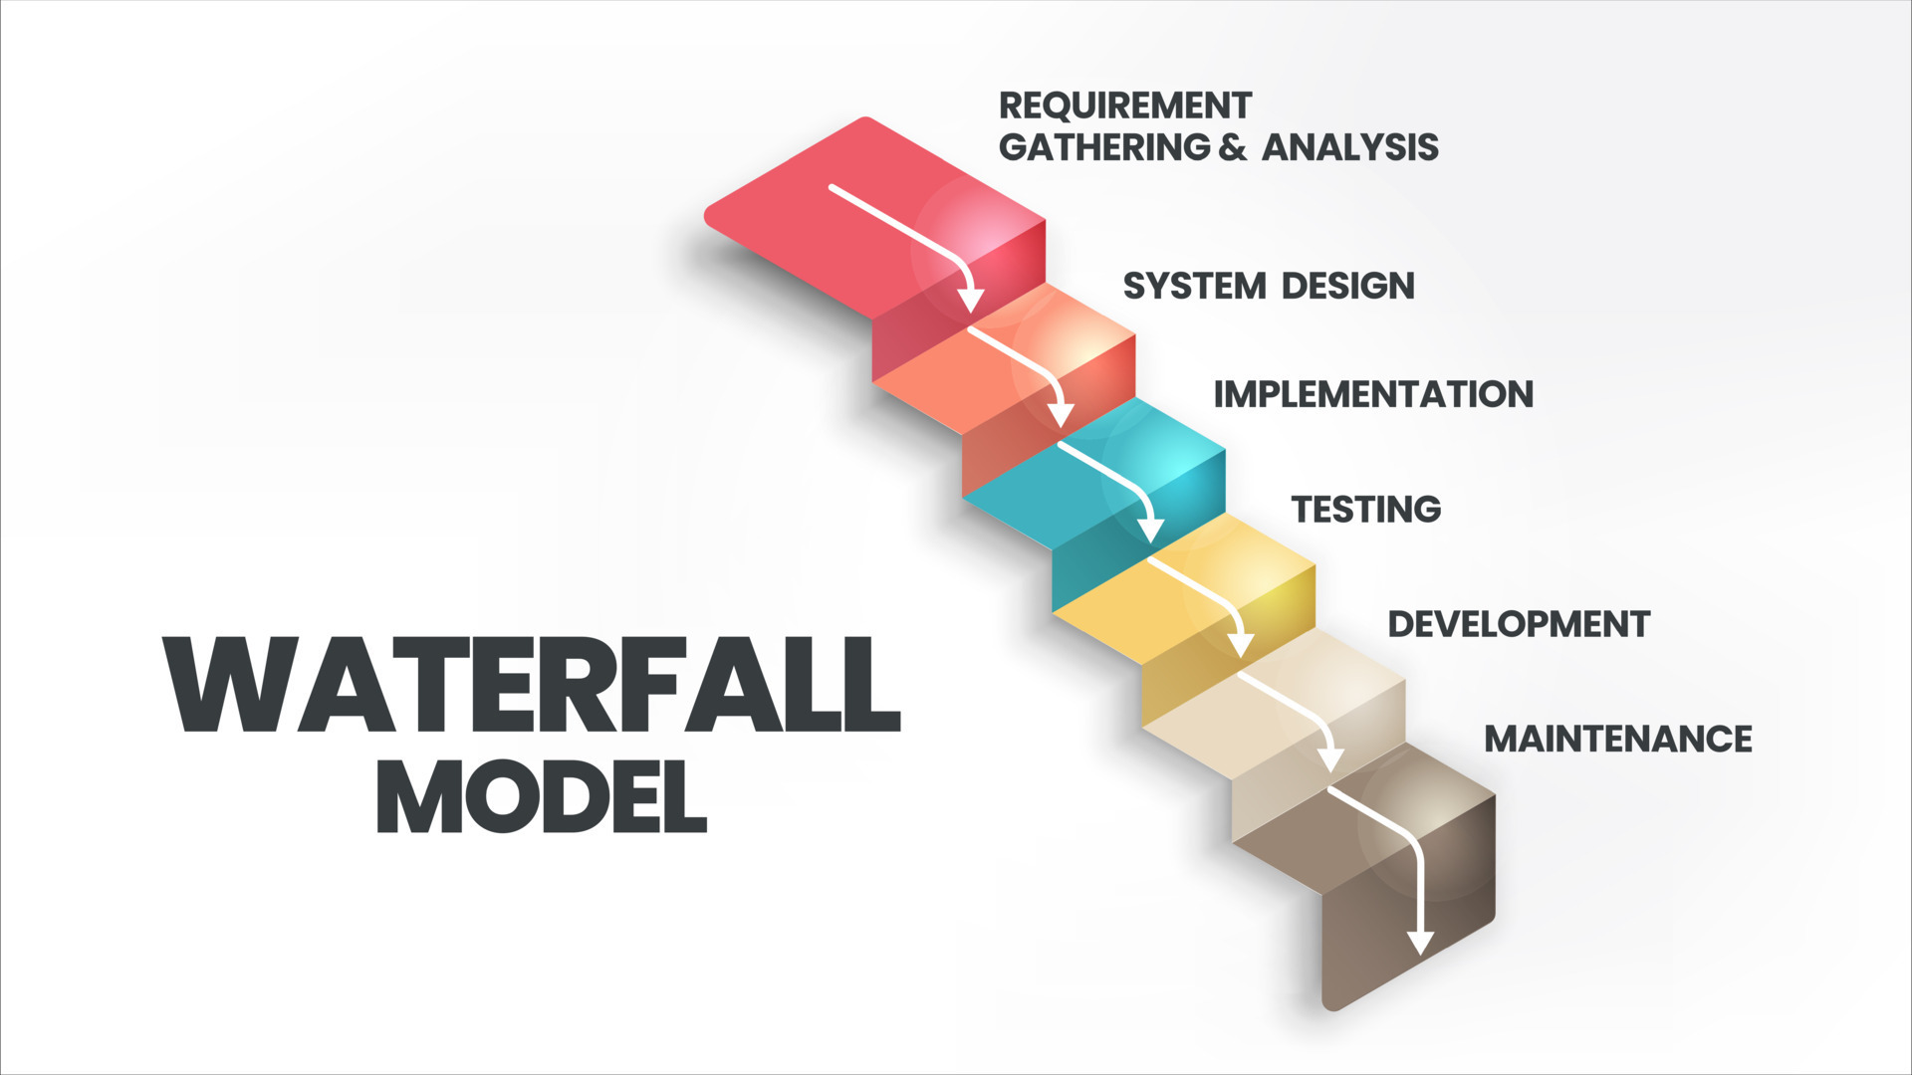
Waterfall Development
Traditional development model with distinct goals for each phase of development
Linear, sequential and plan-driven
Requires detailed documentation prior to starting developments

Slide 10
Waterfall Development cont.
Development for the SNHU Travel Booking System would differ under a waterfall development approach
The requirements would have been defined in the beginning in a detailed document
This would make changes difficult as the project progressed
Development would be completed prior to testing
The issues after development would make it harder to go back and fix something and it would also cost more time, money and resources
By using an agile approach, the SNHU Travel Project would be able to change the focus on the booking site while still in the development process
Since the requirements were not completely defined in the beginning and development was being done in iterations, the team was able to adjust the needs of the clients easily

Slide 11
Agile vs. Waterfall
Agile
The requirements are defined as more information is known as the project progresses, making the final vision hard to plan in the beginning
The project would be unfamiliar and difficult to plan for
You would need to be collaborative with the client to develop a high-value product
Agile has a flexible scope and is harder to estimate the time finished, but are easily adjustable
Waterfall
The requirements would be easily defined in the beginning and would have a clear understanding of the final vision, but this would make adaptations not expected
The project is familiar and client involvement would not be as necessary
Waterfall has a fixed scope and is easier to estimate the time finished, making it easier to plan for deadlines

Slide 12
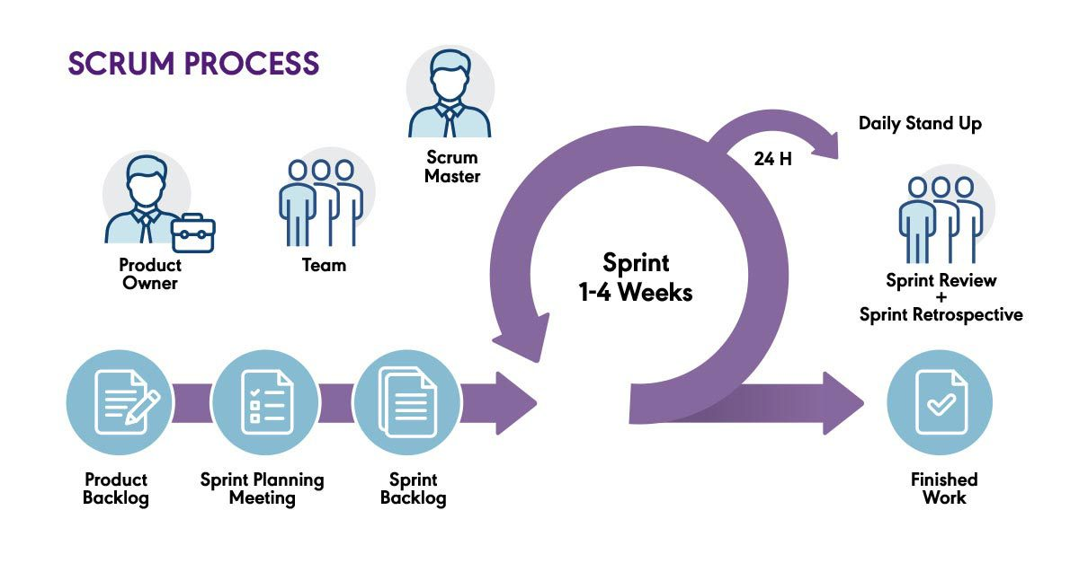
Conclusion
By using a Scrum-agile approach when developing the SNHU Travel project, it will be able to produce a higher quality product that focuses on the customer
Although it will be a tough transition shifting all ChadaTech’s dev. Teams to a Scrum-agile approach, but will enhance the product and build a more cohesive culture

Slide 13
References
Schwaber, K. & Sutherland, J. (2020). The Scrum Guide
Agile Alliance. (2021). Agile project management principles.
Charles G. Cobb. (2015). The Project Manager’s Guide to Mastering Agile : Principles and Practices for an Adaptive Approach. Wiley.

